Slide 1
Project « Whand »
Alain R. Marchand
A new language to control conditioning chambers
Accessible to all, easy to understand and modify:
focus on desired behaviour, not methods
no loops, no overhead, no procedures
no f special characters
explicit names and syntax, comments
fully parallel: order of instructions indifferent
re-use of components
;&[$@~}<

Slide 2
Compare: Random Ratio 5 (reward after 5 lever presses on average)
POLY (Imetronic, Pessac, France):
 | TI | TJ | TK | TL | HLED(1,1) | LED1(1,2) | LED2(1,3) | L1(2,1) | L2(2,2) | D1(4,1) |  |  |  |  |  |  |  |  | NEXT1 | NEXT2 | NEXT3 | CT1
1 | 1800000 |  |  |  | ON |  |  | ON |  |  |  |  |  |  |  |  |  |  | ON |  |  | CTA=0
2 |  |  |  |  |  |  |  |  |  |  |  |  |  |  |  |  |  |  | ON(10+CTA)
3 |  |  |  |  |  |  |  |  |  |  |  |  |  |  |  |  |  |  | CTA>=30(5) | !TI(200) | TI.L1_L=CTB
4 |  |  | 1050 |  |  |  |  |  |  | ON |  |  |  |  |  |  |  |  | !TK(2) |  |  | CTA+1
5 |  |  |  | 5000 |  |  |  |  |  |  |  |  |  |  |  |  |  |  | !TL(200)
6
7
8
9
10 |  |  |  |  |  |  |  |  |  |  |  |  |  |  |  |  |  |  | ON(3) |  |  | CTB=4
11 |  |  |  |  |  |  |  |  |  |  |  |  |  |  |  |  |  |  | ON(3) |  |  | CTB=3
12 |  |  |  |  |  |  |  |  |  |  |  |  |  |  |  |  |  |  | ON(3) |  |  | CTB=5
13 |  |  |  |  |  |  |  |  |  |  |  |  |  |  |  |  |  |  | ON(3) |  |  | CTB=4
14 |  |  |  |  |  |  |  |  |  |  |  |  |  |  |  |  |  |  | ON(3) |  |  | CTB=10
15 |  |  |  |  |  |  |  |  |  |  |  |  |  |  |  |  |  |  | ON(3) |  |  | CTB=9
16 |  |  |  |  |  |  |  |  |  |  |  |  |  |  |  |  |  |  | ON(3) |  |  | CTB=3
17 |  |  |  |  |  |  |  |  |  |  |  |  |  |  |  |  |  |  | ON(3) |  |  | CTB=5
18 |  |  |  |  |  |  |  |  |  |  |  |  |  |  |  |  |  |  | ON(3) |  |  | CTB=3
19 |  |  |  |  |  |  |  |  |  |  |  |  |  |  |  |  |  |  | ON(3) |  |  | CTB=2
20 |  |  |  |  |  |  |  |  |  |  |  |  |  |  |  |  |  |  | ON(3) |  |  | CTB=6
21 |  |  |  |  |  |  |  |  |  |  |  |  |  |  |  |  |  |  | ON(3) |  |  | CTB=8

Slide 3
Compare : Random Ratio 5 (reward after 5 lever presses on average)
MEDstate (Med-Associates, USA):
S3, \ Time Session Length
0.01": SET S = S + 0.01;
SHOW 1,Session,S/60;
IF S/60 >= A(^Session) [@EndSession, @ContinueTiming]
@End: Z^Z_End ---> S4
@Cont: ---> SX
S4, \ Wait for Screen Update and end with
\ STOPABORTFLUSH for Automatic Data Saving
2": ---> STOPABORTFLUSH
\***************************************************
\ MAIN PROGRAM
\***************************************************
S.S.2,
S1, \ Draw first Progressive Ratio from List Z
#START: LIST P = Z(X) ---> S1
S2, \ Test for Correct Lever
#RA(^CorrectLev): ADD B(0), B(1), R;
IF R >= P [@PR_Value_Met, @False]
@PR_Met: ADD B(3);
SET B(6) = P, R = 0;
ZA(^RewardDevice) ---> S3
@False: ---> SX
#R^LeftLever: ADD B(0), B(2) ---> SX
#R^RightLever: ADD B(0), B(2) ---> SX
#Z^Z_End: ---> S5
S3, \ Wait for End of Reward Signal
#Z^Z_End: ---> S5
#Z^Z_EndReward: ---> S4
S4, \ Time Out Interval Following Reward
\ Update Progressive Ratio P from LIST Z
A( imeOutTicks)#T: LIST P = Z(X) ---> S1
#Z^Z_End: ---> S5
S5, \ End of Session - Turn Lights Off
0.01": OFF ^HouseLight, ^LeftLight, ^RightLight ---> S6
S6, \ Holding State at End of Session
1': ---> SX
\ Inputs
^LeftLever = 1
\ Outputs
^Pellet = 3
^HouseLight = 7
\ A() = Control Variables with Assigned Aliases as Defined
Var_Alias Session Length (min) = A(0) \ Default = 60 minutes
Var_Alias Reward Time (sec) = A(3) \ Default = 0.05 seconds
\ List Working Variables Here
\ I = Subscript for the IRT Array C
\ P = Current RR Value
\ R = Ratio Response Counter
\ S = Elapsed Time in Session
\ X = Subscript for Random Ratio List Z
\ Z() = Random Ratio Default List
DIM A = 7
DIM B = 6
LIST Z = 4,3,5,4,10,9,3,5,3,2,6,8
\ Z-Pulses Used in this Program
^Z_Pellet = 1 \ Signal Pellet Reinforcement
^Z_EndReward = 4 \ Signal End of Reward
^Z_End = 32 \ Signal End of Session
\***************************************************
\ Random Ratio Schedule
\ S1 - Set Default Values
\ Session Length (60 minutes)
\ Reward Device (1-Pellet)
\ Reward Time (0.05 seconds)
\***************************************************
S.S.1,
S1, \ First Statement: Wait for START signal, turn HouseLight ON
\ and turn associated stimulus ON.
\ Second Statement: Update screen display with default values
\ for Control Variables. This will show any changes made via
\ the "Configure | Change Variables" Window prior to START.
#START: CLEAR 1,200;
SET A(^RewardTicks) = A(^RewardTime) * 1";
SET A( imeOutTicks) = A( imeOut) * 1";
ON ^HouseLight, ^LeftLight, ^RightLight;

Slide 4
Compare : Random Ratio 5 (reward after 5 lever presses on average)
Whand:
# display # a comment, ignored by Whand
controlpanel # activate interactive panel
# parameters:
max_duration: 20min # session duration
max_rewards: 20 # pellets/session
pulse_duration: 500ms # needed for food_pellet delivery
ratio_list: 5,3,7,8,2,6, \
4, 8,5,2,4,7,6,3, 6,5,7,3,4,5 # list of pseudo-random ratios
# exit conditions (whichever comes first)
exit: when start+max_duration # stop either after session duration
when (count food_pellet=max_rewards)+5s # or after a number of pellets
# procedure
houselight # house light on for the whole session
lever_presented: when start
until count food_pellet=max_rewards
food_pellet: when press_count=ratio # trigger pulse when enough lever presses
until food_pellet+pulse_duration # end pulse after pulse_duration
press_count: when start: 0 # resetting counter: initialize
when food_pellet+epsilon: 0 # reset counter just after a reward
when lever_presented and begin lever_pressed: old+1 # increment counter
ratio: when press_count=0: next ratio_list # get new random ratio from list
# output wiring:
output 1: houselight # connect event to output (output naming)
output 2: lever_presented
output 3: food_pellet
# input wiring:
lever_pressed: pin 1 # connect event to input (input naming)
magazine: pin 2 # input not used in script, just recorded

Slide 5

Installing & running Whand
Unzip Whand in a new directory
install Python 3.6
verify parameters, connections and config files
Create Whand script(s) and 'run file' in subdirectory 'scripts'
Start Whand with RUN_WAND.bat
Click Start or Global start, finish with Global stop

Slide 6
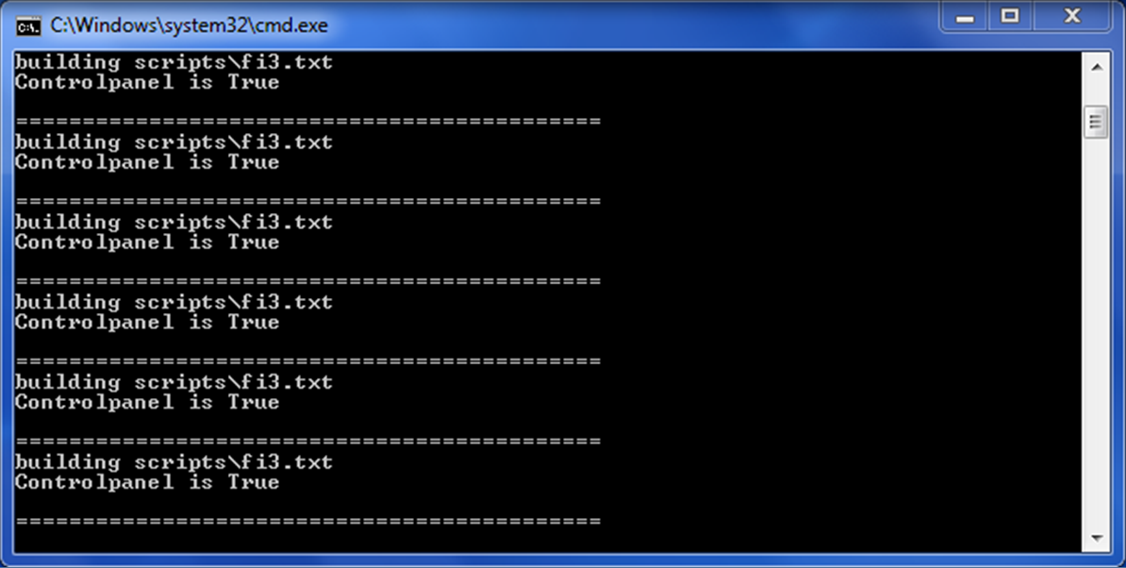
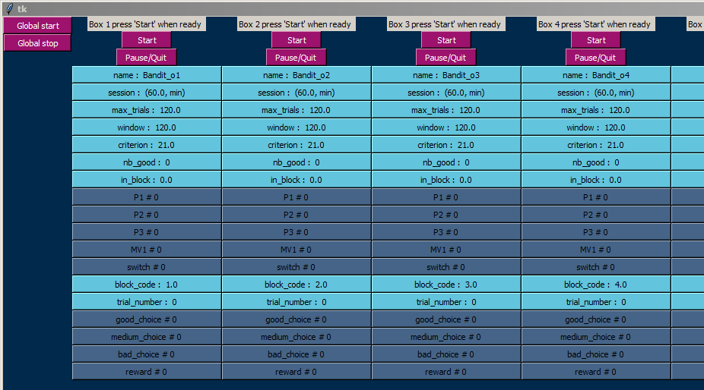
Select file containing script list ? band
bandit_o1, bandit_o2, bandit_o3, bandit_o4, bandit_o5, band it_o3, bandit_o1, bandit_o2
building scripts\bandit_o1.txt
Select file to output results ? MW_J6_01_
File exists: overwrite (Y/N) ? y
============================================
building scripts\bandit_o2.txt
============================================
building scripts\bandit_o3.txt
Running an experiment
with 'run' file (band.txt)

Slide 7

whand_parameters.py file (in Python)
in directory: whand_modules
# global constants ====================================
Timestep=.025 # display refresh period (seconds)
…
# Display options =====================================
Allow_manual=False # interactive buttons
…
Window_position="+0+0" # from top left
…
FalseColor="#456487" # CNRS bleu anthracite clair
…
# I/O options ========================================
Hardware= ASi # ASi for Imetronic or None
…
this file may be modified with caution

Slide 8
Include files
You can record a piece of code in a file for later use.
To make a script, just add in the elements you need.
Example of include file:the connection file
# wiring:
include scripts\connections.txt # D1, HL, etc. are defined here

Slide 9

Connection file (in WHAND language)
in directory: whand_scripts
# Wiring for Imetronic conditioning box (hardwired) + event names
MV1: pin 1 # magazine 1 visit
MV2: pin 7 # magazine 2 visit
noP1: pin 10 # inverted lever 1 input
noP2: pin 11 # inverted lever 2 input
noP3: pin 5 # inverted lever 3 input
P1: when end noP1 until noP1 or start # non inverted lever 1 input
P2: when end noP2 until noP2 or start # non inverted lever 2 input
P3: when end noP3 until noP3 or start # non inverted lever 3 input
output 1: D1 # food dispenser 1
output 4: HL # houselight
output 7: D2 # food dispenser 2
output 9: Ta # tone (5000 Hz)
output 10: SP1 # present lever 1
output 11: SP2 # present lever 2
output 8: SP3 # present lever 3
MV1, P1, D1… are arbitrary names, depend on experiment

Slide 10
Programming in WHAND:
only one type of instruction
name: when condition1: value1
when condition2: value2
etc.
(values persist until a new condition is realized)

Slide 11
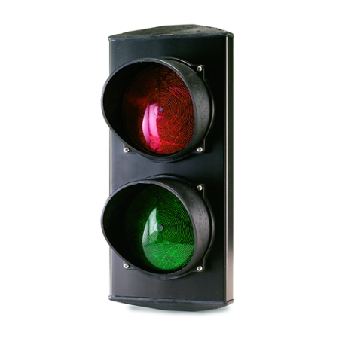
Events
A condition must be an event (e.g. a test formula)
An event has value true or false (may change with time)
Other types of values are number, delay, state or list
An event + a delay → a delayed event
start, begin(evt), end(evt) are very brief events
true
false
evt
time
begin(evt)
end(evt)
delay
delay
evt+delay

Slide 12
A simple script: Fixed Ratio 1
(long form)
# parameters: # this line is a comment
max_duration: when start: 20min # freely choose object names
max_rewards: when start: 20 # max rewards
# procedure:
houselight when start: true # houselight
lever_presented: when start: true # lever
exit: when count(pellet)=max_rewards: true # whichever comes first
when start+max_duration: true # an event + a delay
pellet: when lever_presented and begin(lever_pressed) : true # FR1
when pellet+500ms: false # end of dispenser pulse
# wiring:
include scripts\connections.txt: when start: true # actual inputs and outputs

Slide 13
Fixed Ratio 1
(short form)
# parameters: # this line is a comment
max_duration: 20min # freely choose object names
max_rewards: 20 # max rewards
# procedure:
houselight # houselight: when start: true
lever_presented # or 'lever_presented when start'
exit when count(pellet)=max_rewards # whichever comes first
when start+max_duration # an event + a delay
pellet when lever_presented and begin(lever_pressed) # true is implicit
until pellet+500ms # end of dispenser pulse
# wiring:
include scripts\connections0.txt # actual inputs and outputs

Slide 14
Short forms:
name when condition
→ name: when condition: true
name until condition
→ name: when condition: false
name
→ name: when start: true
name: constant_value
→ name: when start: constant_value
name: variable_value
→ name: when start: variable_value
when change(variable_value ): variable_value

Slide 15
The power of lists
a list may contain values of any nature
all operations and functions distribute on lists
ramp (4) * 2s → 2s, 4s, 6s, 8s
lists are cyclic (repeat sequence when finished)
functions: cumul integrates a list of numbers or delays
cumul (3s, 1s, 6s, 5s, 2s) → 3s, 4s, 10s, 15s, 17s
any (a list of events) → a single event (multiple 'or')
next (a list) retrieves list items one by one
etc.

Slide 16
Magazine training, with lists
# Magazine training: 20 pellets on VT 30s
max_pellets: 20
HL # HL code for houselight
random_list: 15, 44, 37, 25, 27, 45, 21, 31, 20, 24, \
24, 41, 44, 22, 35, 30, 21, 44, 27, 20
# procedure:
interval_list: random_list*1s # convert numbers to delays
delay_list : cumul interval_list # recompute delays from start
event_list : start+delay_list # convert delays to event list
D1: when any event_list # convert event list to one event
until D1+500ms # pulse for pellet dispenser
exit: when (count D1=max_pellets)+10s # D1 code for pellets
# wiring:
include scripts\connections.txt # D1 and HL are defined here

Slide 17

and more…
Operators
and, or, is, isnot, +, -, *, /, =, !=, >, <, >=, <=
add, pick, sort, match, find, isin, within
to, since, powr
Functions
sqrt, intg, absv, logd, alea, proba
not, any, all, next, pointer, inter, have, hasvalue, text, idem
begin, end, change, order, sequence, lastchange, occur, lasted
count, cumul, steps, ramp, shuffle
pin, key, load, call
time, timeis, dayis, dateis, weekis
Other
start, true, false, epsilon, empty, exit, take
controlpanel, output, store, print, analog
hide, show, include, unused
be, state, number, delay, event, list
ms, s, mn, min, day, wk, monday, january, etc.

Slide 18
Summary file in directory: whand_data
showed variables
Box | Time | name | session | max_trials | window | criterion | nb_good | in_block | P1 | P2 | P3 | MV1 | switch | block_code | trial_number | good_choice | medium_choice | bad_choice | reward
1 | 1150.8 | Bandit_o1 | (60.0, min) | 120 | 120 | 21 | 68 | 120 | 68 | 25 | 27 | 0 | 0 | 1 | 120 | 68 | 27 | 25 | 68
2 | 1084.0 | Bandit_o2 | (60.0, min) | 120 | 120 | 21 | 82 | 120 | 82 | 20 | 18 | 0 | 0 | 2 | 120 | 82 | 20 | 18 | 75
3 | 1723.5 | Bandit_o3 | (60.0, min) | 120 | 120 | 21 | 80 | 120 | 16 | 80 | 24 | 0 | 0 | 3 | 120 | 80 | 16 | 24 | 69
4 | 1224.3 | Bandit_o4 | (60.0, min) | 120 | 120 | 21 | 92 | 120 | 15 | 92 | 13 | 0 | 0 | 4 | 120 | 92 | 13 | 15 | 78
5 | 1992.8 | Bandit_o5 | (60.0, min) | 120 | 120 | 21 | 20 | 120 | 39 | 61 | 20 | 0 | 0 | 5 | 120 | 20 | 61 | 39 | 54
6 | 1157.5 | Bandit_o3 | (60.0, min) | 120 | 120 | 21 | 67 | 120 | 26 | 67 | 27 | 0 | 0 | 3 | 120 | 67 | 26 | 27 | 66
7 | 1797.0 | Bandit_o1 | (60.0, min) | 120 | 120 | 21 | 88 | 120 | 88 | 17 | 15 | 0 | 0 | 1 | 120 | 88 | 15 | 17 | 76
8 | 1919.3 | Bandit_o2 | (60.0, min) | 120 | 120 | 21 | 54 | 120 | 54 | 35 | 31 | 0 | 0 | 2 | 120 | 54 | 35 | 31 | 62
show name, session, max_trials
show window, criterion, nb_good, in_block
show count(P1), count(P2), count(P3), count(MV1)
show switch, count(switch), block_code, trial_number
show count(good_choice), count(medium_choice), count(bad_choice)
show count(reward)

Slide 19
Data files in directory: whand_data
Date version: 30/12/2018
Date expérience: 13/01/2019
Heure expérience: 16:14:19
Expérience dans cage: 3
Animal:
Numéro séance: 1
Séance précédente: 0
Séance suivante: 0
Gène:
Traitement:
Dose:
Voie:
Solvant:
Produit2:
Lésion:
Remarque:
Nom fichier données: c:\whand\data\ MW_J6_01_3.e01
Nom fichier exercice: c:\whand\scripts\bandit_14.xls
[fin section etiquette]
Instant(s10): Event1:
0.0 1
155.0 11
160.3 15
183.0 6
183.0 22
191.8 15
371.0 6
371.5 22
396.5 15
463.0 6
463.8 22
467.3 18
470.0 15
480.0 7
480.5 16
481.8 25
484.3 13
Format identical to
SKFiles raw format
may be analyzed with
TraiteSK_V12c.xlsm
user-entered
file name
series 01
cage 3
time (x 0.1 s)
= 18.3 s
event codes
lever press
pellet delivery

Slide 20
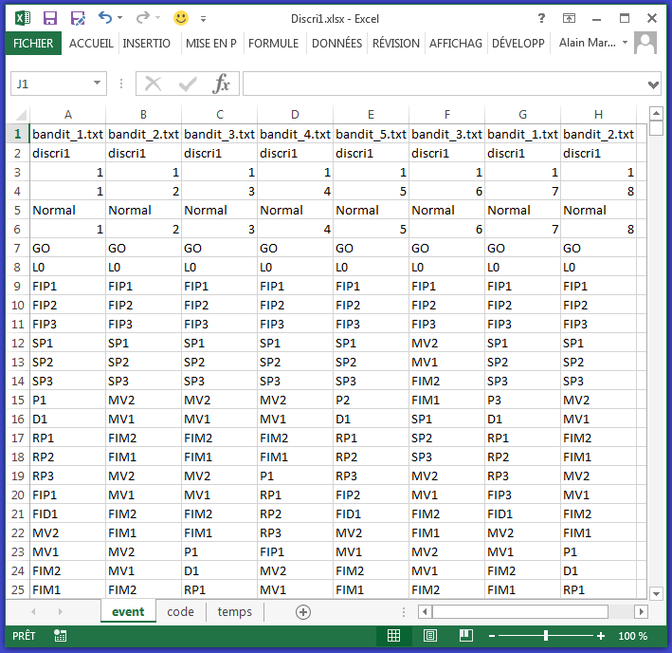
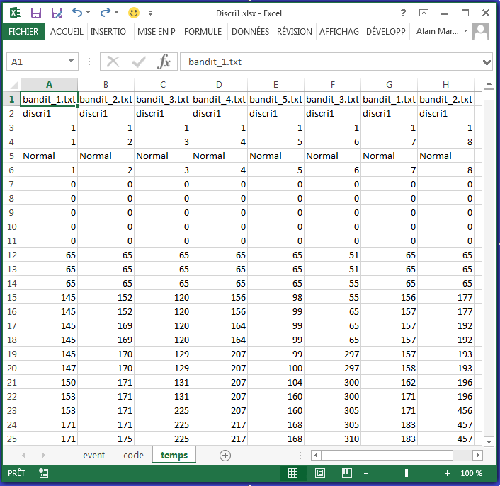
Data sheets under TraiteSK_V12c
Subject
Event
Time

Slide 21
Caution: updating and resetting
Updating is instantaneous during a time step. Changing interdependent values may lead to infinite loops: needs delays
Example: Random Ratio 5
…
ratio_list: 5,3,7,8,2,6,4, 8,5,2,4,7,6,3, 6,5,7,3,4,5
D1: when nb_presses>=ratio # depends on nb_presses and ratio
until D1+500ms
nb_presses: when start: 0 # depends on D1 for resetting
when D1+epsilon: 0 # reset is delayed to avoid loop
when press: old nb_presses+1 # incrementing requires 'old'
ratio: when start: next ratio_list # depends on D1 for new value
when D1+2*epsilon: next ratio_list # change only after nb_presses=0

Slide 22

Conditions in transitions
At the instant a variable changes, its value should not be used !
In 'and' expressions, apparently impossible conditions may become transiently true
when i=5 and V(i)=3
true
false
evt
time
delay
delay
safe window

Slide 23

Some error messages
Fatal errors
*** Error: unbalanced brackets ***
*** Error: source or configuration file not found ***
*** Error: Node is already defined ***
*** Error: nature conflict ***
*** Indeterminate nature: Please add a 'be' instruction…
*** Configuration/Script mismatch: this i/o is declared as 'unused' ***
…
Warnings
    *** Warning: program without exit condition ***
    *** Warning: probable circular dependencies ***
    …

Slide 24
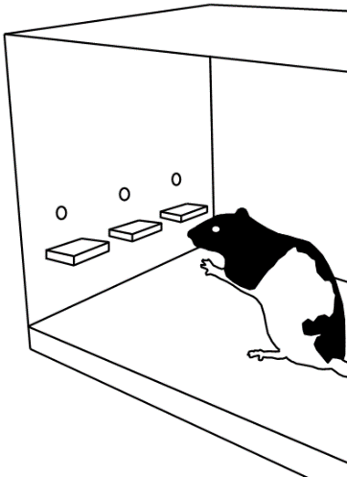
Three-arm bandit (p.1/5)
# Bandit task by Alain - Jan 2019
# Discrete choices between three levers with probabilistic rewards
# parameters
name:"Bandit_14"
switch_list: 1,4 # (multiple) reversal
max_session_duration: 60mn
max_trials: 120
window: 30 # preceding trials for criterion
criterion: 21 # good trials required in window
initial_time: 7s # before first trial
ITI_time: 7s # except reward time and lever move
reward_time: 500ms # pulse for the dispenser - adds to ITI
no_reward_time: 500ms # nothing or timeout - adds to ITI
lever_move_time: 500ms # adds to ITI
# basic functions
include "scripts\connections_b.txt" # definition file for standard events
exit when start+max_session_duration
when (count(trial_phase is ITI)=max_trials)+ITI_time
HL # houselight on
D1: reward # pellet dispenser controlled by 'reward’

Slide 25
Three-arm bandit (p.2/5)
# lever presentations
SP1: trial_phase is in (lever_presentation, choice)
SP2: trial_phase is in (lever_presentation, choice)
SP3: trial_phase is in (lever_presentation, choice)
# trial structure
trial_phase: when start: wait
when start+initial_time: lever_presentation
when (trial_phase is lever_presentation)+lever_move_time: choice
when (reward or nothing)+epsilon: ITI # delay to break cycle
when end reward+ITI_time: lever_presentation # ITI_time from end of reward
when end nothing+ITI_time: lever_presentation # add lever presentation time
# lever assignment
block_code: when start: next switch_list # 1 means (good,bad,medium), etc.
when switch: next switch_list
be number # set object nature in definition
output(100): block_code+80 # code for block saved to data file

Slide 26
Three-arm bandit (p.3/5)
# monitor response - careful of timing because of cyclic list
pressed(1): when trial_phase is choice and begin P1 until pressed(1)+4*epsilon
pressed(2): when trial_phase is choice and begin P2 until pressed(2)+4*epsilon
pressed(3): when trial_phase is choice and begin P3 until pressed(3)+4*epsilon
pressed_ID: pressed find true # which lever has been pressed
race_guard: when (pressed_ID>0)+epsilon until race_guard+3*epsilon
# chosen lever
good_choice: race_guard and block_list(block_code)(pressed_ID) is good
medium_choice: race_guard and block_list(block_code)(pressed_ID) is medium
bad_choice: race_guard and block_list(block_code)(pressed_ID) is bad
# compute and deliver rewards (with dispenser pulse)
reward: when good_choice and give(good)=1
when medium_choice and give(medium)=1
when bad_choice and give(bad)=1
until reward+reward_time
nothing: when good_choice and give(good)=0
when medium_choice and give(medium)=0
when bad_choice and give(bad)=0
until nothing+no_reward_time

Slide 27
Three-arm bandit (p.4/5)
# update probabilistic rewards after each reward
give(good): when start or end good_choice: next good_list
give(medium): when start or end medium_choice: next medium_list
give(bad): when start or end bad_choice: next bad_list
# cyclic list representing good (true) or bad (false) trials, oldest at the end
cycle: when start: empty # start with empty list
when switch+ITI_time: empty # reset not too soon after a switch
when race_guard+epsilon and old count(cycle)<window: \
old(good_choice add cycle)
when race_guard+epsilon and old count(cycle)>=window: \
old(good_choice add cycle(ramp(window-1)))
# criterion to change block
nb_good: count(pick cycle) # number of true values in cyclic list
switch: when count(cycle)=window and (nb_good>=criterion)+epsilon
until switch+epsilon
# lists
good_list: when start: load("scripts\random80.txt") # reward if 1, no reward if 0
medium_list: when start: load("scripts\random50.txt")
bad_list: when start: load("scripts\random20.txt")
block_list: (good,bad,medium), (good,medium,bad), (medium,good,bad) \
,(bad,good,medium), (bad,medium,good), (medium,bad,good)

Slide 28
Three-arm bandit (p.5/5)
# additional variables for display
session: text(max_session_duration/60s, " min")
trial_number: count(trial_phase is choice) # in whole session
in_block: when start or switch: 0 # nb trials in the current block
when any pressed: old+1
percent_good: count good_choice*100/ \
(count good_choice+count medium_choice+count bad_choice)
percent_medium: count medium_choice*100/ \
(count good_choice+count medium_choice+count bad_choice)
percent_bad: count bad_choice*100/ \
(count good_choice+count medium_choice+count bad_choice)
# display
controlpanel
show name, session, max_trials
show window, criterion, nb_good, in_block
show count(P1), count(P2), count(P3), count(MV1)
show count(switch), block_code, trial_number
show count(good_choice), count(medium_choice), count(bad_choice)
show count(reward), percent_good, percent_medium, percent_bad

